Slide 1


Computer Architecture Experiment
5th lab
College of Computer Science & Engineering
Zhejiang University

Slide 2
Topics
0、Basic Knowledge
1、Function Units Design
2、Single-cycle CPU Design
3、Multiple-cycle CPU Design
4、5-stage of pipeline CPU Design
5、Pipelined CPU with stall
6、Pipelined CPU with forwarding
7、Pipelined CPU resolving control hazard
8、Pipelined CPU support execution 16 MIPS Instructions
9、Course Review

Slide 3
Outline
Experiment Purpose
Experiment Task
Basic Principle
Operating Procedures
Precaution

Slide 4
Experiment Purpose
Understand the principles of Pipelined CPU Stall
Understand the principles of Data hazard
Master the method of Pipelined CPU Stalls Detection and Stall the Pipeline.
master methods of program verification of Pipelined CPU with Stall

Slide 5
Experiment Task
Design the Stall Part of Datapath of 5-stages Pipelined CPU
Modify the CPU Controller, adding Condition Detection of Stall.
Verify the Pp. CPU with program and observe the execution of program

Slide 6
Data Hazard Definition
Data Hazards arise when an instruction depends on the results of a previous instruction in a way that is exposed by the overlapping of instructions in the pipeline.
When inst. i executes before instr. j, there are data hazards:
RAW, i.e. instr. j read a source before instr. i writes it.
WAW, i.e. instr. j write an operand before instr. i writes it.
WAR, i.e. instr. j write a destination before instr. i read it.

Slide 7
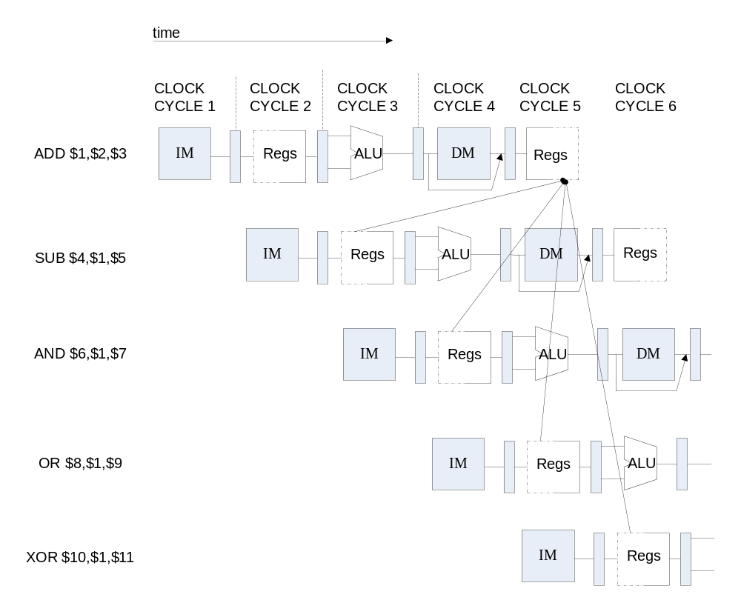
Instruction Demo

Slide 8
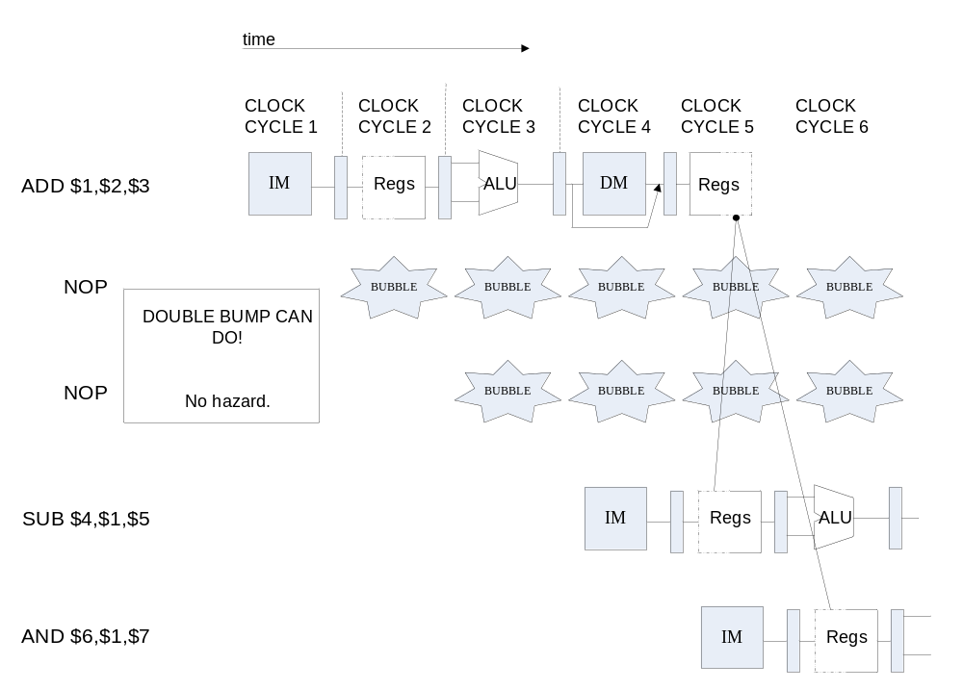
Data Hazard Causes Stalls

Slide 9
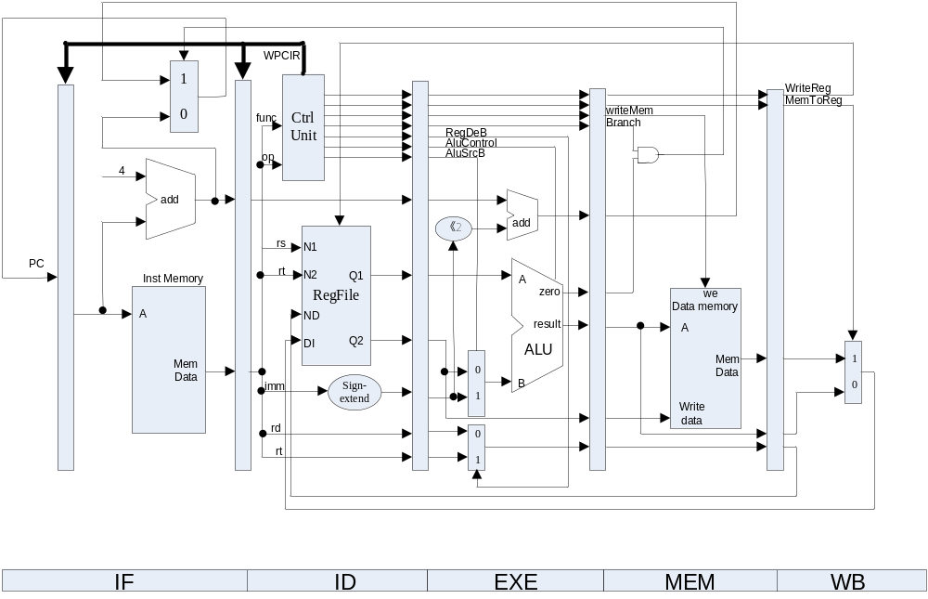
How to Stall the Pipeline

Slide 10
In Which Conditions it Causes Stall
assign AfromEx = (if_rs==rd) & (if_rs != 0) & (opcode ==`OP_ALUOp); //if instr.rs=id inst.rd and id instr = ALUOp
Other expressions：
BfromEx：if instr.rt=id instr.rd and id instr = ALUOp
AfromMem：if instr.rs=ex instr.rd and ex instr = ALUOp
BfromMem ： if instr.rt=ex instr.rd and ex instr = ALUOp
AfromExLW ： if instr.rs=id instr.rt and id instr = LW
BfromExLW ： if instr.rt=id instr.rt and id instr = LW
AfromMemLW： if instr.rs=ex instr.rt and ex = LW
BfromMemLW ： if instr.rt=ex instr.rt and ex = LW
assign stall = AfromEx || …

Slide 11
Controller Module
if_instr: if stage instruction
Instr: id stage instruction
ex_instr: ex stage instruction
mem_instr: mem stage instruction
wb_instr: wb stage instruction
assign cu_wpcir = stall;
Output signal cu_wpcir to ID Module，then ID Module Output id_wpcir to Top Module.

Slide 12
Pipelined CPU Top Module
module top (input wire CCLK, BTN3, BTN2, input wire [3:0]SW, output wire LED, LCDE, LCDRS, LCDRW, output wire [3:0]LCDDAT);
assign pc [31:0] = if_npc[31:0];
if_stage x_if_stage(BTN3, rst, pc, mem_pc, mem_branch, id_wpcir, …
IF_ins_type, IF_ins_number,ID_ins_type,ID_ins_number);
id_stage x_id_stage(BTN3, rst, if_inst, if_pc4, wb_destR,…, id_wpcir,
ID_ins_type, ID_ins_number, EX_ins_type, EX_ins_number..);
ex_stage x_ex_stage(BTN3, id_imm, id_inA, id_inB, id_wreg, ..
EX_ins_type, EX_ins_number, MEM_ins_type, MEM_ins_number);
mem_stage x_mem_stage(BTN3, ex_destR, ex_inB, ex_aluR, …
MEM_ins_type, MEM_ins_number, WB_ins_type, WB_ins_number);
wb_stage x_wb_stage(BTN3, mem_destR, mem_aluR, …
WB_ins_type, WB_ins_number,OUT_ins_type, OUT_ins_number);

Slide 13
IF Module and ID Module
In IF Module，When it Causes Stalls
PC will not be changed.
ID_ins_number will not be changed.
ID_ins_type will not be changed.
In ID Module， When it Causes Stalls
reg_inst should be 0
pc4 will not be changed.
ID_ins_number will not be changed.
ID_ins_type = INST_TYPE_NONE

Slide 14
Observation Info
Input
  West Button: Step execute
  South Button: Reset
  4 Slide Button: Register Index
Output
  0-7 Character of First line: Instruction Code
  8 of First line : Space
  9-10 of First line : Clock Count
  11 of First line : Space
  12-15 of First line : Register Content
  Second line : “stage name”/number/type
  stage name: 1-”f”, 2-”d”, 3-”e”, 4-”m”, 5-”w”

Slide 15
Thanks!

